Slide 1


sorry
CONTENT UNDER DEVELOPMENT…

Slide 2
MED-IM

Slide 3
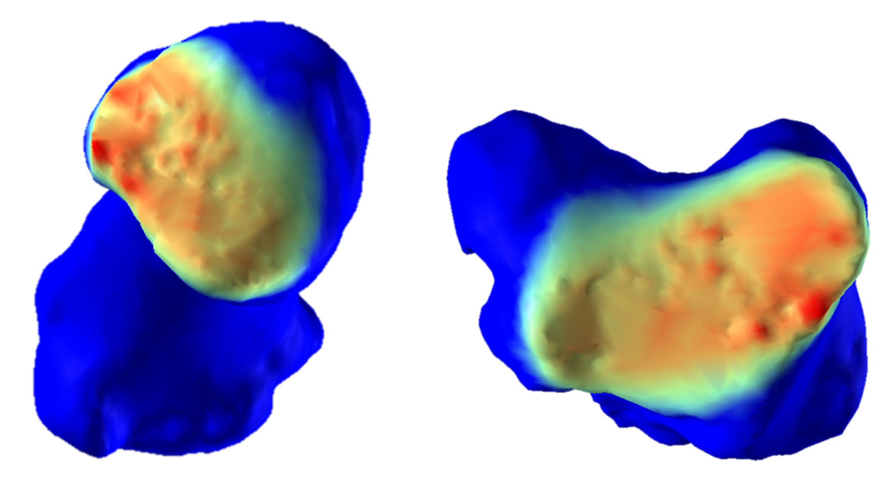
EVALUATING INTRA-ARTICULAR JOINT PRESSURE USING MEDICAL IMAGING TECHNOLOGY
PURPOSE
Understand pressure distribution patterns within human joint to better predict and prevent the occurrence of degenerative disorders (e.g. osteoathritis).
HOW
Develop an algorithm that models patient-specific cartilage morphologies from CT images collected during different tasks and maps the corresponding pressure distribution.
FINDINGS
Recurrent pressure distribution patterns observed that are associated with the preliminary location of degenerative changes.
© Copyright DOURTHE TECHNOLOGIES 2019

Slide 4
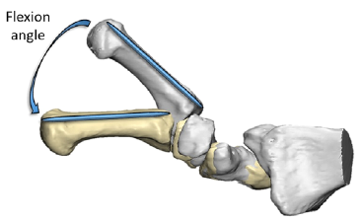
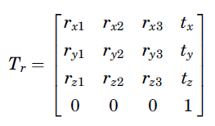
ASSESSING HUMAN JOINTS MOBILITY USING STATIC MEDICAL IMAGING TECHNOLOGY
PURPOSE
Develop a marker-free motion capture technique using medical imaging to assess and understand human joint mobility.
THUMB MOBILITY
HOW
Develop an algorithm that calculates 3D transformations between bone models generated via CT imaging reconstruction.
FINDINGS
The algorithm developed in this study offers new possibility to assess the mobility of small human joints, which would not be measurable via traditional motion capture.
© Copyright DOURTHE TECHNOLOGIES 2019

Slide 5
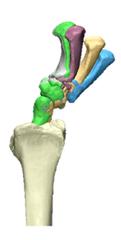
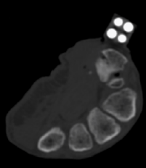
MEASURING THE ACCURACY OF DYNAMIC MEDICAL IMAGING TO ASSESS THUMB MOTION
PURPOSE
Apply dynamic medical imaging to overcome the limitations of current motion capture technologies regarding the quantification of mobility for small joints.
Dynamic thumb tracking
HOW
Collect and process dynamic CT images while controlled motion is applied to cadaveric samples embedded with silicon nitride beads.
FINDINGS
Dynamic medical imaging technology can be used to visualize and quantify 3D thumb mobility, making it a valuable tool to assess small joints’ kinematics in vivo.
© Copyright DOURTHE TECHNOLOGIES 2019

Slide 6
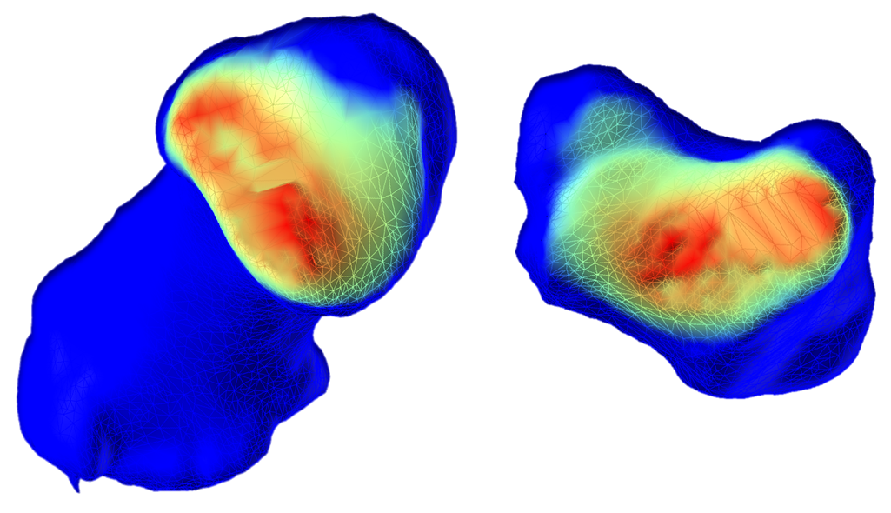
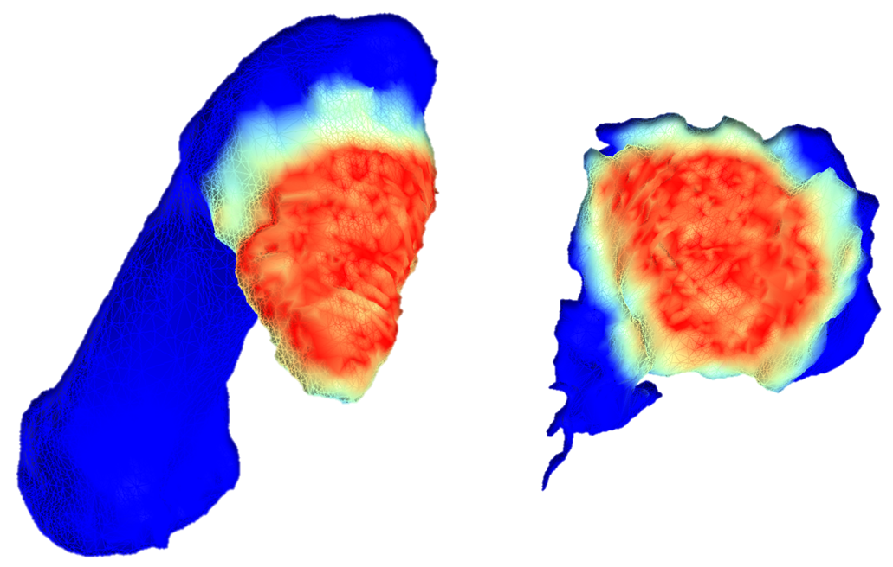
ASSESSING THE MORPHOLOGICAL IMPACT OF THUMB OSTEOARTHRITIS
PURPOSE
Better understand how degenerative joint diseases occurs by comparing pressure distribution patterns between healthy and osteoarthritic (OA) subjects.
HEALTHY
HOW
Design a proximity mapping algorithm to estimate and compare patient-specific intra-articular pressure distribution patterns from medical images.
OA
FINDINGS
This study improved our understanding of OA development by assessing how joint pressure is distributed during tasks of daily living for healthy and arthritic subject.
© Copyright DOURTHE TECHNOLOGIES 2019

Slide 7
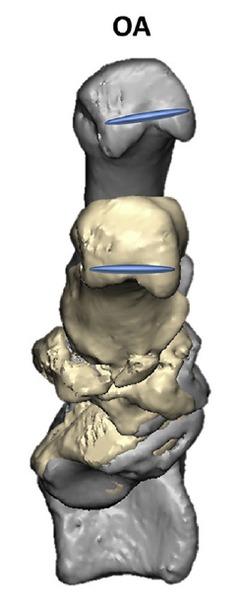
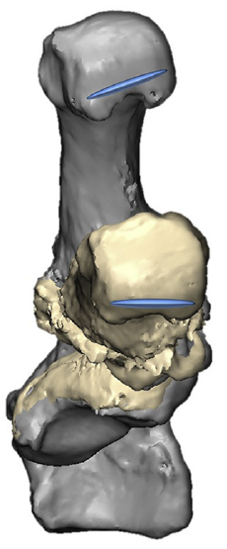
MEASURING THE IMPACT OF TOTAL THUMB REPLACEMENT ON HAND MOBILITY
PURPOSE
Understand how total thumb replacement prosthesis affect and/or restore the mobility of patients who suffered from advanced joint degeneration.
OA
HOW
Collect patient’s pre- and post-surgery CT scans while performing defined movements and quantify mobility using custom-made medical imaging-based motion capture algorithm.
IMPLANT
FINDINGS
Thumb arthroplasty partially restores joint function and mobility but cannot fully replicate the kinematics of the healthy thumb. Such results can potentially help enhance current implant designs.
© Copyright DOURTHE TECHNOLOGIES 2019

Slide 8
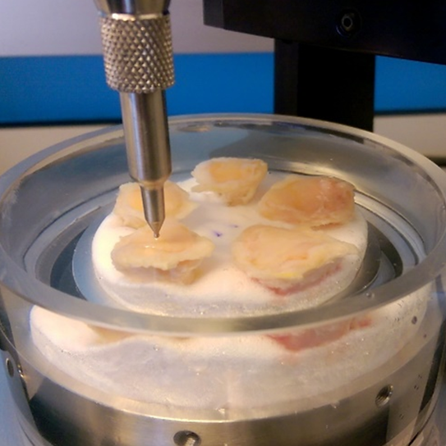
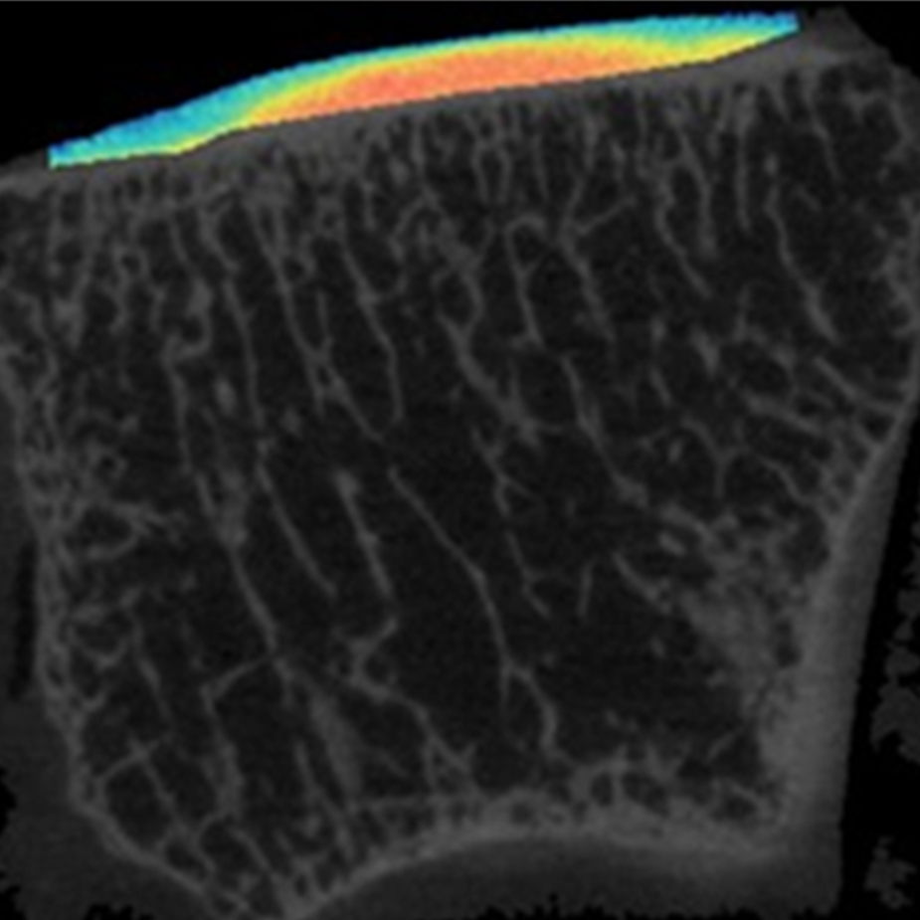
ASSESSING SOFT TISSUES PROPERTIES USING CONTRAST ENHANCED MEDICAL IMAGING
PURPOSE
Enable the patient-specific in vivo assessment of soft tissue morphology and mechanical properties using a non-destructive medical imaging-based approach.
HOW
Measure cartilage behavior using custom indentation technology and collect contrast-enhanced CT scans to assess the association between mechanical and image properties.
FINDINGS
This work provides a new method for the patient-specific assessment of cartilage properties, as well as a dataset for the development of more accurate computer models of human joints.
© Copyright DOURTHE TECHNOLOGIES 2019

Slide 9
SPORTS

Slide 10
MEASURING THE IMPACT OF COMPRESSION GARMENTS ON SHOULDER STABILITY
PARTNER
Per4ma Sports Technology LTD is a Canadian company that designs compression garments with the objective to improve athletic performance and promote post-injury recovery.
PURPOSE
Compare the Per4ma garments to a leading competitor and a control with respect to its effect on mobility and stability performances, posture, comfort and fatigue.
FINDINGS
The Per4ma shirt may contribute to an improved control of shoulder mobility, thereby limiting the risks of shoulder injuries.
Due to privacy restrictions, full disclosure of the study’s conclusions is not permitted
© Copyright DOURTHE TECHNOLOGIES 2019

Slide 11
COMPARISON BETWEEN FOOT PRESSURE MAPPING TECHNOLOGIES
PARTNER
Orpyx Medical Technologies Inc. is a Canadian company that designs foot pressure measurement technologies used to improve human health and advance sports performance.
PURPOSE
Compare the accuracy of the Orpyx LogR Gen 2 prototype to the well-established Pedar System and a Kistler force plate with respect to several biomechanical variables.
FINDINGS
Comparable center of pressure trajectories and ground reaction forces were found among the different tested systems.
Due to privacy restrictions, full disclosure of the study’s conclusions is not permitted
© Copyright DOURTHE TECHNOLOGIES 2019

Slide 12
MEASURING THE IMPACT OF CUSTOM ORTHOTICS ON LEGS AND FEET BIOMECHANICS
PARTNER
Dr. Scholl's® is a footwear and orthopedic foot care brand who recently introduced the concept of self-selected customized orthotics in the market.
PURPOSE
To quantify the impact of self-selected customized orthotics on the legs and feet during long periods of standing, as well as during regular and uphill power walking.
FINDINGS
The results of this study indicate some benefits regarding the use of self-selected customized orthotics with respect to lower limb biomechanics and perceived fatigue.
Due to privacy restrictions, full disclosure of the study’s conclusions is not permitted
© Copyright DOURTHE TECHNOLOGIES 2019

Slide 13
DEVELOPMENT OF AN IMAGE ANNOTATION TOOL FOR ALGORITHM PERFORMANCE ASSESSMENT
PARTNER
CURV Labs is a Canadian company that uses artificial intelligence to help assess, identify and manage musculoskeletal performance and problems.
PURPOSE
To build an image annotation algorithm to manually label landmarks on 2D video data for comparison with the results of CURV Labs’ machine learning algorithm outcome.
FINDINGS
Due to privacy restrictions, the disclosure of the study’s conclusions is not permitted.
© Copyright DOURTHE TECHNOLOGIES 2019

Slide 14
DATA SCIENCE
&
MACHINE LEARNING

Slide 15
DEVELOPMENT OF A
3D TRANSFORMATIONS TOOLBOX
DESCRIPTION
This toolbox contains custom Python codes enabling essential 3D operations for applications in the fields of Motion Capture and 3D Image Processing.
CONTENT
Global to local transformations | Calculates the rotation and translation matrices allowing the transformations of a data set from a global to a local coordinate system (and vice versa).
Motion capture processing | Use rigid body dynamics to extract the 3D trajectories of joint centers from static and dynamic marker-based motion capture data (e.g. Vicon).
Nearest (Euclidean) neighbor | Find the nearest (Euclidean) neighbor between two data sets of points.
Iterative Closest Point (ICP) | Use an ICP method to find the best-fit transform that maps solid A on to solid B (for 3D registration).
© Copyright DOURTHE TECHNOLOGIES 2019

Slide 16
DEVELOPMENT OF A
SIGNAL PROCESSING TOOLBOX
DESCRIPTION
This toolbox contains custom Matlab and Python codes enabling essential signal processing operations enabling the filtering, interpolation and analysis of time series (including biosignals).
CONTENT
Denoising | Moving average, Gaussian and Median filter, Detrending, LSTM filter, TKEO and Z-scores.
Filtering and Spectral analysis | Linear-phase finite impulse response (FIR) filter, Welch method, Fast Fourier Transform (FFT).
Interpolation and Resampling | Cubic spline interpolation/resampling of time series, Data reshaping tool, NaN finder.
Signals comparison | Signals delay assessment (using FFT), Intraclass correlation (ICC) calculation, Dynamic time wrapping excursions between time series.
© Copyright DOURTHE TECHNOLOGIES 2019

Slide 17
MOTION CAPTURE ENHANCEMENT USING SEQUENCE MODELING AND RECURRENT NEURAL NETWORK
BACKGROUND
Marker-less motion capture technologies are cheaper and more accessible than marker-based multi-camera systems. If their accuracy is deemed sufficient, they have the potential to become great clinical tools for orthopedics and injury risk assessment.
However, research has indicated that such technologies have limited accuracy when it comes to measuring complex movements that have narrower amplitudes.
OBJECTIVE
Train a Recurrent Neural Network to enhance the performance of the Microsoft Kinect 3D camera. More specifically, the model's aim is to learn the mapping from Kinect joint centers trajectories to Vicon* joint angles.
*multi-camera marker-based motion capture technology, considered here as Gold Standard
© Copyright DOURTHE TECHNOLOGIES 2019

Slide 18
REAL VS. FAKE NEWS CLASSIFICATION USING
NATURAL LANGUAGE PROCESSING
BACKGROUND
Since 2016, the term Fake News has been used a lot across many forms of Media. With easy access to publishing materials online, it became harder for most people to know whether a source of information should be considered Real or Fake News.
Ultimately, most News articles can be classified using science and fact-checking. But can we use Natural Language Processing and Machine Learning to find patterns to automatically differentiate Real from Fake News?
OBJECTIVE
Train a Naive Bayes Machine Learning model to detect distinguishing patterns between Real and Fake News.
© Copyright DOURTHE TECHNOLOGIES 2019

Slide 19
PREDICTING OCEAN WATER TEMPERATURE USING LINEAR REGRESSION
BACKGROUND
The California Cooperative Oceanic Fisheries Investigations (CalCOFI) are a unique partnership of the California Department of Fish & Wildlife, NOAA Fisheries Service and Scripps Institution of Oceanography.
Their focus is the study of the marine environment off the coast of California, the management of its living resources, and monitoring the indicators of El Nino and climate change.
OBJECTIVE
Train a Linear Regression model to predict the ocean water temperature based on different metrics from the California Cooperative Oceanic Fisheries Investigations (CalCOFI) Database.
© Copyright DOURTHE TECHNOLOGIES 2019

Slide 20
PREDICTING RISK OF CORONARY HEART DISEASE USING SUPPORT VECTOR MACHINE
BACKGROUND
The Framingham Heart Study (FHS) is an epidemiologic study begun in Framingham in 1948 with 5,209 men and women. Since that time the FHS has studied three generations of participants resulting in biological specimens and data from nearly 15,000 participants.
This clinically and genetically well-characterized population is a valuable scientific source that is maintained under the joint stewardship of Boston University and the NHLBI.
OBJECTIVE
Train a Support Vector Machine classifier to predict the risk of developing coronary heart disease within 10 years using data from the Framingham Heart Study.
Additional challenge: implement cross-validation and over-sampling techniques to deal with the imbalance of the dataset.
© Copyright DOURTHE TECHNOLOGIES 2019

Slide 21
DETECTING FRAUDULENT CREDIT CARD TRANSACTIONS USING LOGISTIC REGRESSION
BACKGROUND
The datasets contains transactions made by credit cards in September 2013 by European cardholders. The dataset is highly unbalanced, where the positive class (frauds) account for 0.172% of all transactions (close to 300,000 transactions total).
The dataset contains only numerical input variables that are the result of a Principal Component Analysis, where the original features remain confidential.
OBJECTIVE
Train a Logistic Regression model to identify fraudulent credit card transactions.
Additional challenge: implement cross-validation and over-sampling techniques to deal with the imbalance of the dataset.
© Copyright DOURTHE TECHNOLOGIES 2019

Slide 22
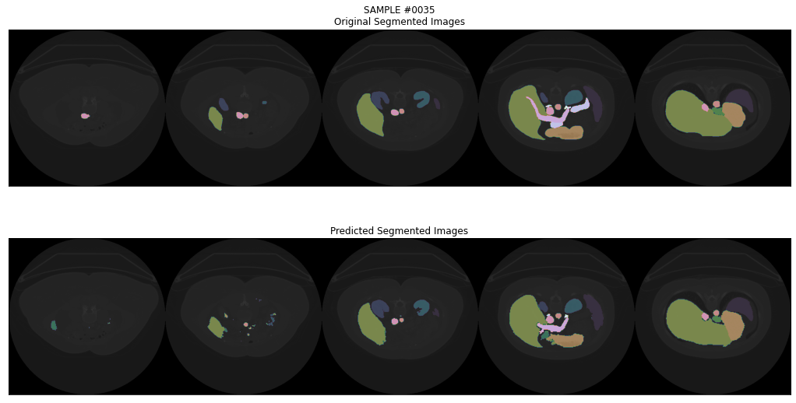
MULTI-ORGAN IMAGE SEGMENTATION USING MULTI-SCALE PYRAMID 3D FCN
OBJECTIVE
Implement a Multi-Scale Pyramid V-shaped 3D Fully Convolutional Network (FCN) architecture enabling the automated segmentation of multiple organs from CT image.
PREVIEW
REAL
PREDICTIONS
Slice A
Slice B
Slice C
Slice A
Slice B
Slice C
© Copyright DOURTHE TECHNOLOGIES 2020

Slide 23
COMPUTER
VISION

Slide 24
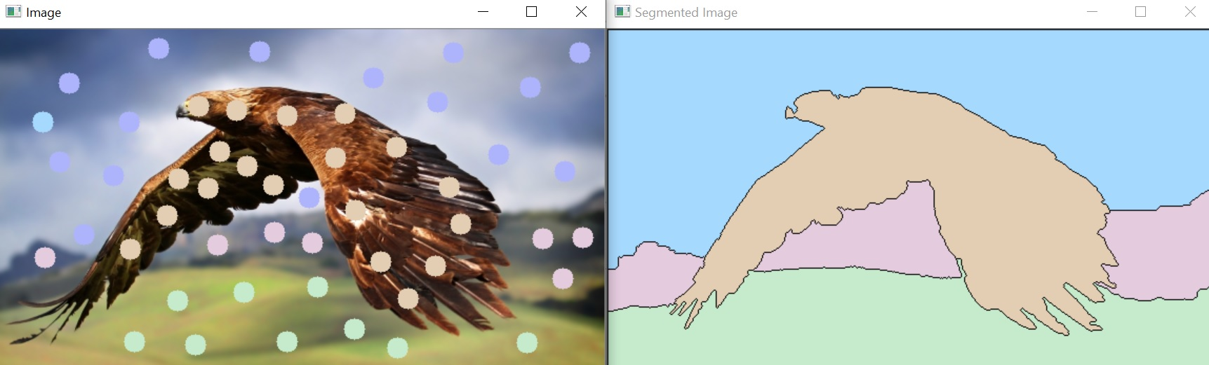
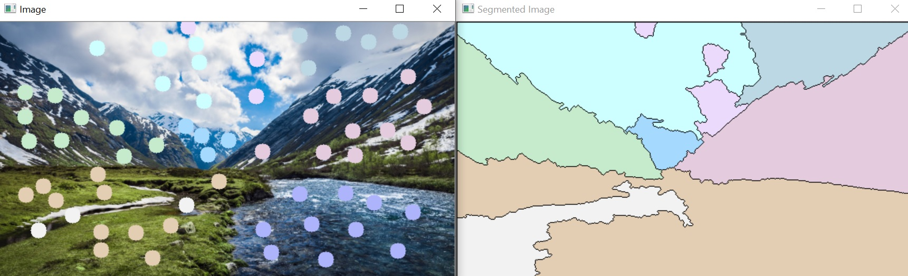
SEMI-AUTOMATED IMAGE SEGMENTATION USING THE WATERSHED ALGORITHM
OBJECTIVE
Build a function enabling the semi-automated segmentation of 2D images using the functionality of the Watershed Algorithm.
ALGORITHM PREVIEW
In order to use the functionality of the Watershed algorithm, the user simply has to click on the display image to define the location of markers.
© Copyright DOURTHE TECHNOLOGIES 2019

Slide 25
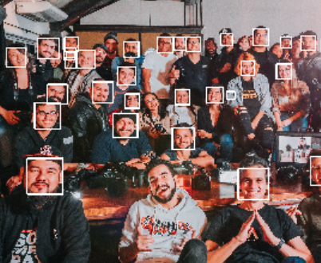
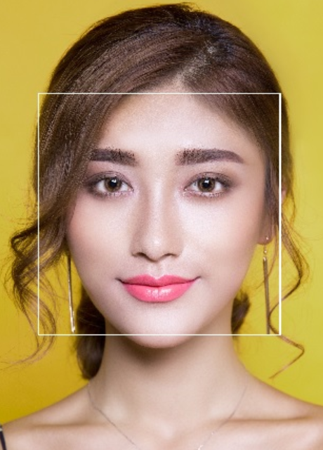
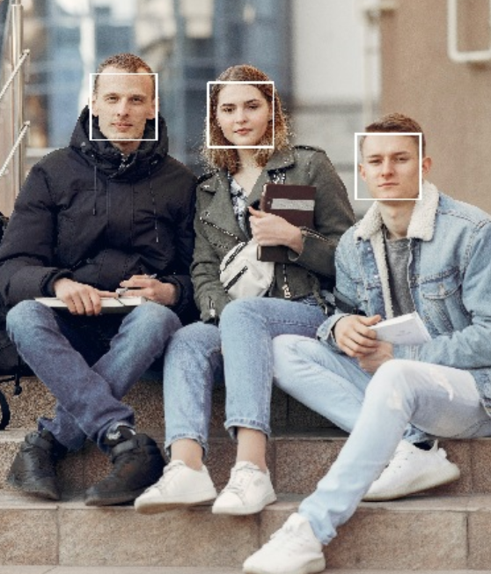
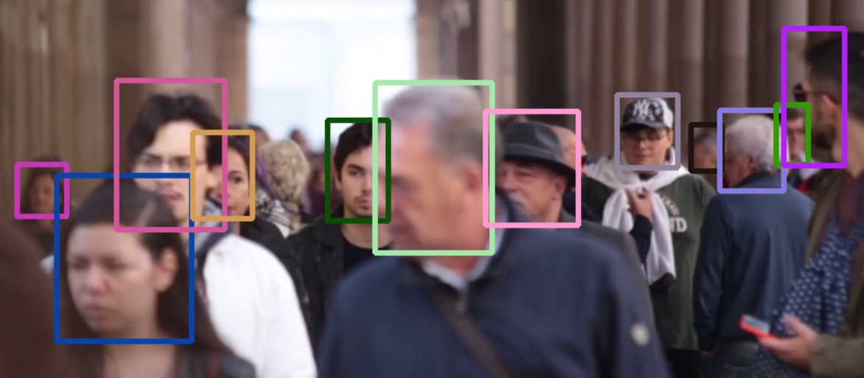
AUTOMATED FACE DETECTION USING
HAAR CASCADES AND TRACKING APIS
OBJECTIVE
Build an algorithm enabling the automated and semi-automated detection/tracking of faces on images and videos using the functionality of Haar cascades and various tracking APIs.
ALGORITHM PREVIEW
© Copyright DOURTHE TECHNOLOGIES 2019

Slide 26
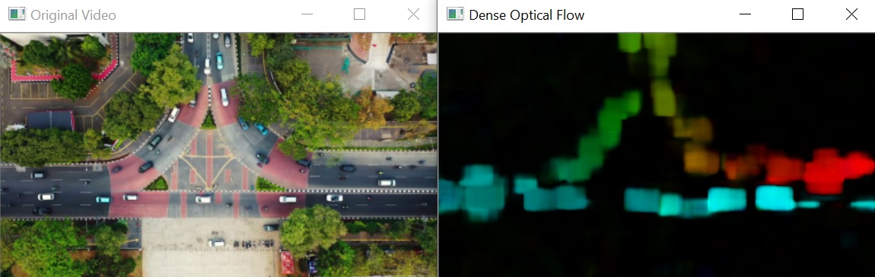
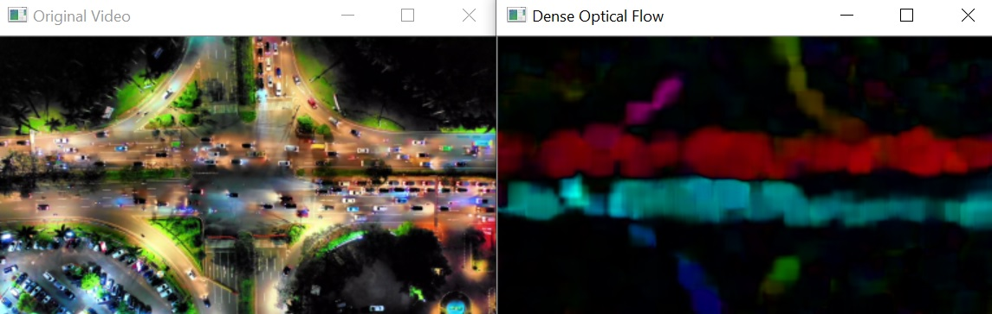
AUTOMATED MOTION DETECTION USING
DENSE OPTICAL FLOW MAPPING
OBJECTIVE
Build an algorithm enabling the automated detection of motion on loaded or live videos using Dense Optical Flow and the functionality of the Gunnar Farneback's algorithm.
ALGORITHM PREVIEW
The algorithm allows to either load a video or run a live feed from your webcam and will open two windows to display to original video (or live feed) and the resulting dense optical flow mapping (color coded using HSV color mapping).
© Copyright DOURTHE TECHNOLOGIES 2019

Slide 27
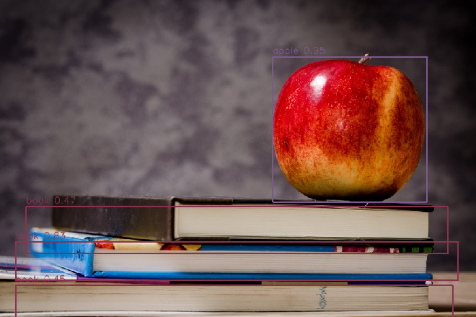
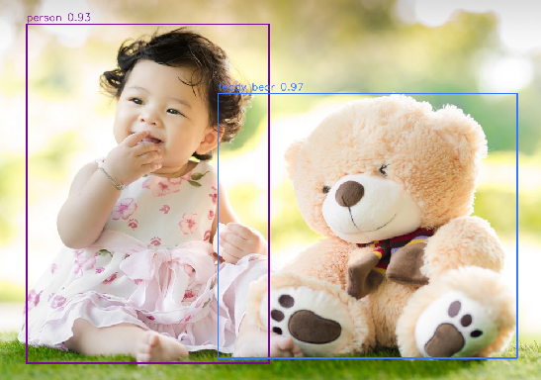
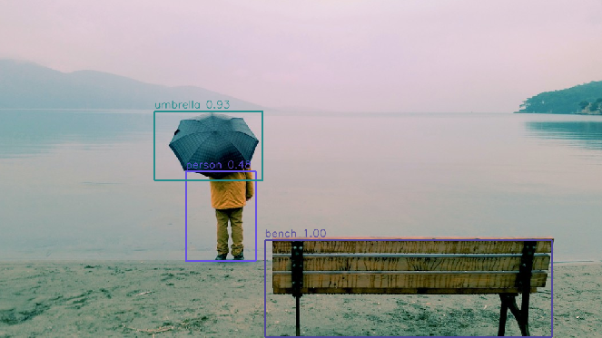
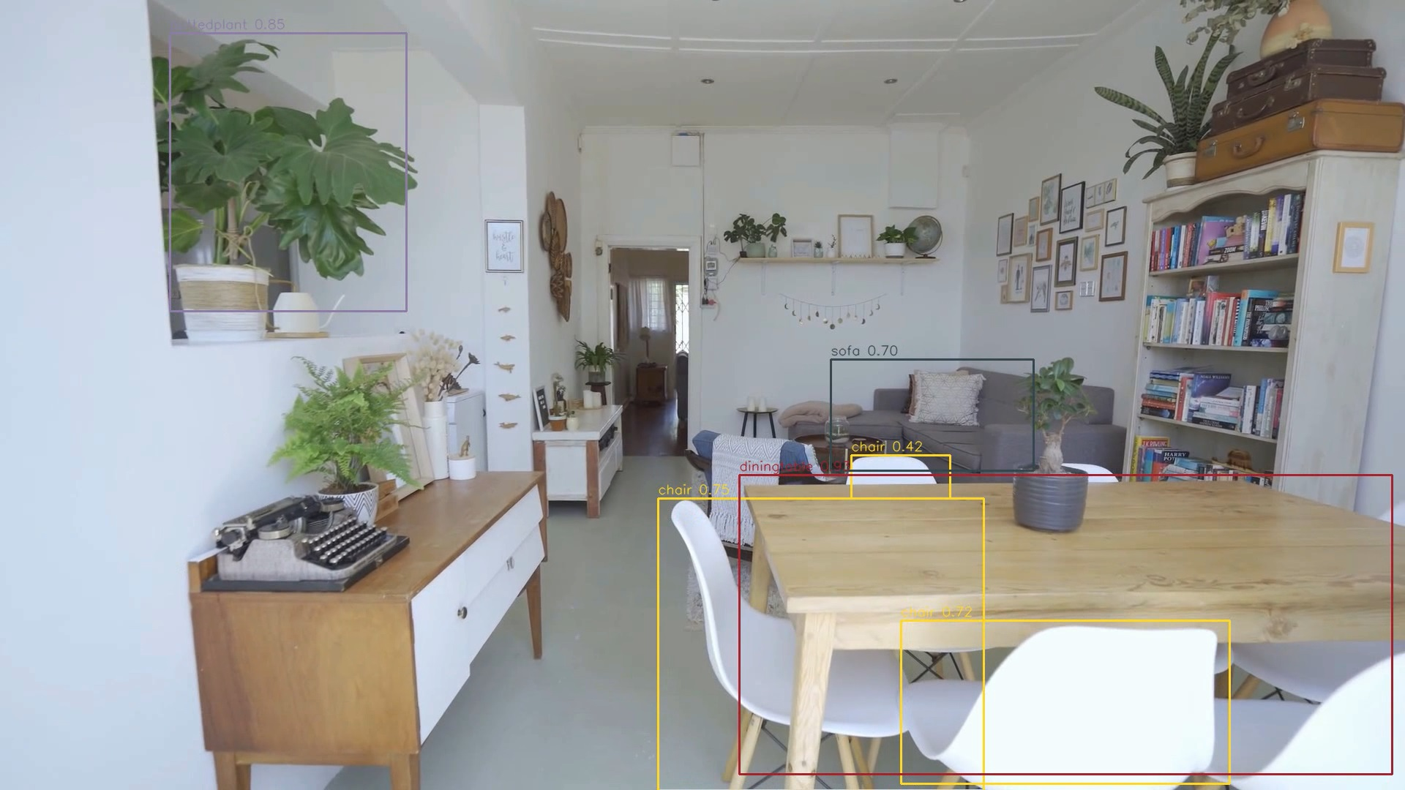
IMPLEMENTATION OF THE PRE-TRAINED YOLO MODEL FOR AUTOMATED OBJECT DETECTION
OBJECTIVE
Build an algorithm enabling the automated detection and tracking of objects on images and videos using the pre-trained weights of the deep learning YOLO (You Only Look Once) model.
ALGORITHM PREVIEW
The algorithm results in images/videos where each identified object is contoured by a rectangle, around which the corresponding object label and probability is displayed.
© Copyright DOURTHE TECHNOLOGIES 2019

Slide 28
OLD SLIDES

Slide 29
COMPUTER VISION PROJECTS
This repository includes a few custom python codes written to
solve specific computer vision problems
CONTENT PREVIEW
(additional content constantly being developed)
img annotation | Allow the manual annotation of body landmarks by importing a data set of 2D images of people running (for validation of the automated algorithm)
© Copyright DOURTHE TECHNOLOGIES 2019

Slide 30
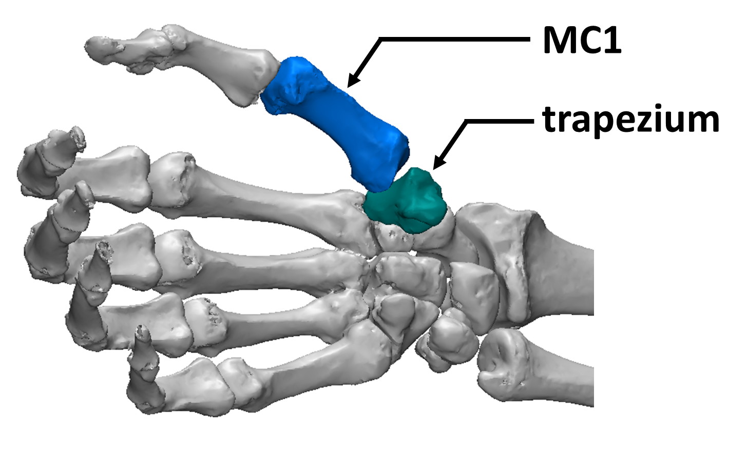
PURPOSE- develop a novel medical imaging-based approach
to measure the morphological and mechanical properties
of cartilage in vivo.
METHODS
STEP 1- CT scans collected in a custom rig with embedded load cell
during functional tasks.
STEP 2- 3D reconstruction of the hand.
STEP 3- Design an algorithm estimating intra-articular
pressure based on a biomechanical model of the cartilage.
STEP 4- Comparison of pressure distribution patterns.
RESULTS
Peak pressure was consistently located around the same region
of the thumb’s articular surface during power grasp.
These results may explain why degenerative changes are
usually observed around this location during the primary stages of
osteoarthritis development.
CONCLUSION- the algorithm developed for this study is a valuable tool that allows clinicians to estimate the distribution of contact pressure within joints in vivo.
© Copyright DOURTHE TECHNOLOGIES 2019

Slide 31
PURPOSE- develop a marker-free motion capture technique using medical imaging to assess and understand thumb mobility.
METHODS
STEP 1- Collect CT scans of healthy volunteers in positions of maximal
thumb extension, flexion, abduction and adduction
STEP 2- Evaluate thumb mobility using a custom-made
algorithm calculating 3D transformations between bone
models generated via CT image reconstruction
THUMB MOBILITY
TRANSFORM
RESULTS
The analysis showed that thumb mobility is allowed via both
3D rotations and translation of the entire articular chain.
The fact that the thumb experiences rotations in all 3 dimensions during
thumb flexion supports the existence of a screw-home mechanism.
CONCLUSION- The thumb plays a significant role in basic hand function. The algorithm developed in this study offers new possibility to assess the mobility of small human joints, which would not be measurable via traditional marker-based motion capture.
© Copyright DOURTHE TECHNOLOGIES 2019

Slide 32
PURPOSE- apply dynamic medical imaging to overcome the limitations of current motion capture technologies regarding the quantification of the mobility of small joints (e.g. fingers).
METHODS
STEP 1- dynamic CT scans acquired from 6 cadaveric human forearms,
while a motion simulator imposed thumb opposition.
STEP 2- 3D reconstruction of the hand for each frame using a
semi-automated segmentation algorithm.
STEP 3- technique’s accuracy assessment using the variation
in distance between silicon nitride beads.
Silicon nitride beads
Dynamic thumb tracking
RESULTS
Regardless of the limited (and optimized) radiation dose used
during dynamic CT scanning, high levels of consistency and accuracy
were found when comparing motion patterns between specimen.
CONCLUSION- This study concluded that dynamic medical imaging technology can be used to visualize and quantify 3D thumb mobility, making it a valuable tool to assess small joints’ kinematics in vivo.
© Copyright DOURTHE TECHNOLOGIES 2019

Slide 33
PURPOSE- better understand how degenerative joint diseases occurs by comparing pressure distribution patterns between healthy and osteoarthritic (OA) subjects.
METHODS
STEP 1- CT scans collected in a custom rig during basic thumb movements
and functional tasks.
STEP 2- 3D reconstruction of the hand.
STEP 3- Design a proximity mapping algorithm to estimate
intra-articular pressure from medical images.
STEP 4- Comparison of pressure distribution patterns
between healthy and OA subjects.
HEALTHY
OA
RESULTS
Distinct proximity patterns were observed across tasks with a
recurrent pattern found around a specific region of the joint.
Important joint degeneration and joint space narrowing were observed
among OA patients, leading to larger estimated intra-articular pressure.
CONCLUSION- This study improved our understanding of OA development by assessing how joint pressure is distributed during tasks of daily living for healthy and arthritic subject.
© Copyright DOURTHE TECHNOLOGIES 2019

Slide 34
PURPOSE- quantify the impact of osteoarthritis (OA) and total thumb joint replacement on thumb mobility.
METHODS
Several patients with advanced OA symptoms were tested.
STEP 1- Collect CT pre- and post-surgery scans of the patient’s affected
hand while performing thumb movements (e.g. thumb flexion)
STEP 2- Evaluate thumb mobility using a custom-made algorithm
calculating 3D transformations between bone models
generated via CT image reconstruction
OA
IMPLANT
RESULTS
The study showed that advanced thumb OA can largely
restricts the mobility of the thumb.
It also showed that total thumb arthroplasty is able to partially restore
thumb function, but cannot fully replicate the kinematics of the healthy thumb.
CONCLUSION- The quantification of thumb mobility in OA patients pre- and post-surgery improved our understanding of the disease, and can help enhance current implant designs.
© Copyright DOURTHE TECHNOLOGIES 2019

Slide 35
PURPOSE- develop a novel medical imaging-based approach to measure the morphological and mechanical properties of
cartilage in vivo.
METHODS
STEP 1- Extract human joints samples from cadavers.
STEP 2- Measure the load-displacement behavior using cartilage custom
indentation technology.
STEP 3- Obtain contrast-enhance high resolution scans of the
samples to measure their composition.
STEP 4- Assess the correlation between cartilage
mechanical properties and composition.
RESULTS
A positive correlation was found between the composition
and mechanical properties of the cartilage.
CONCLUSION- This work provides a new method for the non-destructive in vivo assessment of cartilage properties, as well as a greater understanding of cartilage behavior and a dataset for the development of more accurate computer models of human joints.
© Copyright DOURTHE TECHNOLOGIES 2019

Slide 36
INDUSTRY PARTNER- Per4ma Sports Technology LTD.
BACKGROUND- Per4ma Sports Technology LTD is a Canadian company that designs compression garments with the objective to improve athletic performance and promote post-injury recovery
STUDY OBJECTIVE
Compare the Per4ma garments to a leading competitor (Under Armour) and a control condition (non-compressive garment) with respect to its effect on performance, posture, comfort and fatigue
VARIABLES OF INTEREST
The following variables were collected and compared across garments:
Passive/Active joint reactions | Garment compression | Peak power output | Fatigue index
RESULTS ABSTRACT*
The Per4ma shirt provided more resistance during slow and fast shoulder flexion movements, which may contribute to an improved control of shoulder mobility, thereby limiting the risks of shoulder injuries
*Due to privacy restrictions, full disclosure of the study’s conclusions is not permitted
© Copyright DOURTHE TECHNOLOGIES 2019

Slide 37
INDUSTRY PARTNER- Orpyx Medical Technologies Inc.
BACKGROUND- Orpyx Medical Technologies Inc. is a Canadian company that designs foot pressure measurement technologies used to improve human health and advance sports performance
STUDY OBJECTIVE
Compare the accuracy of the Orpyx LogR Gen 2 prototype to the well-established Pedar System (Novel, Germany) and a Kistler force plate (Kistler Group, Switzerland) with respect to several biomechanical variables
VARIABLES OF INTEREST
The following variables were collected and compared across systems:
Center of pressure trajectory| Plantar pressure distribution | Ground reaction forces
RESULTS ABSTRACT*
Comparable center of pressure trajectories and ground reaction forces were similar among the different tested systems
*Due to privacy restrictions, full disclosure of the study’s conclusions is not permitted
© Copyright DOURTHE TECHNOLOGIES 2019

Slide 38
INDUSTRY PARTNER- Dr. Scholl’s®
BACKGROUND- Dr. Scholl's® is a footwear and orthopedic foot care brand who recently introduced the concept of self-selected customized orthotics in the market
STUDY OBJECTIVE
Three distinct studies were performed over a year-long project to quantify the impact of self-selected customized orthotics on the legs and feet during long periods of standing, as well as during regular and uphill power walking
VARIABLES OF INTEREST
The following variables were collected and compared with a control condition:
Perceived fatigue level | Subjective comfort | EMG activity in the quad and calf muscles Foot trajectory | Arch morphology | Plantar pressure distribution
RESULTS ABSTRACT*
The results of this study indicate some potential benefits regarding the use of
self-selected customized orthotics with respect to lower limb biomechanics
and perceived fatigue
*Due to privacy restrictions, full disclosure of the study’s conclusions is not permitted
© Copyright DOURTHE TECHNOLOGIES 2019

Slide 39
3D TRANSFORMATIONS TOOLBOX
This toolbox includes a few custom python codes enabling
essential operations and transformations on 3D objects
CONTENT PREVIEW
(additional content constantly being developed)
Transformations between coordinate systems | Calculates the rotation and translation matrices allowing the transformations of a data set from a global to a local coordinate system (and vice versa)
Find joint centers (motion capture) | Find the coordinates of a joint center using static and dynamic motion capture data (e.g. Vicon)
Nearest (Euclidean) neighbor | Find the nearest (Euclidean) neighbor between two data sets of points.
Iterative Closest Point (ICP) | Use an ICP method to find the best-fit transform that maps points A on to points B
© Copyright DOURTHE TECHNOLOGIES 2019

Slide 40
SIGNAL PROCESSING TOOLBOX
This toolbox includes a few custom Matlab and Python codes enabling essential signal processing operations
CONTENT PREVIEW
(additional content constantly being developed)
Denoising | Moving average, Gaussian and Median filter, Detrending, LSTM filter, TKEO and Z-scores
Filtering and Spectral analysis | Linear-phase finite impulse response (FIR) filter, Welch method, Fast Fourier Transform (FFT)
Interpolation and Resampling | Cubic spline interpolation/resampling of time series, Data reshaping tool, NaN finder
Signals comparison | Signals delay assessment (using FFT), Intraclass correlation (ICC) calculation, Dynamic time wrapping excursions between time series
© Copyright DOURTHE TECHNOLOGIES 2019

Slide 41
MACHINE LEARNING PROJECTS
This repository includes a few custom python codes written to solve classification problems using convolutional neural network
CONTENT PREVIEW
(additional content constantly being developed)
Motion capture enhancement | Developed a Recurrent Neural Network (RNN) architecture with a unique bidirectional Long Short Term Memory (LSTM) layer to regress the mapping from joint centers tracking to joint angles.
Cats vs. Dogs | Uses a deep convolutional neural network (with data augmentation) to address the Cats v Dogs full Kaggle Challenge.
Horses vs. Humans | Uses transfer learning combined with a local deep convolutional neural network (with data augmentation) to enable a 99.9% classification accuracy using images of horses and humans.
© Copyright DOURTHE TECHNOLOGIES 2019

Slide 42
DRAFTS

Slide 43

© Copyright DOURTHE|TECH 2019

Slide 44
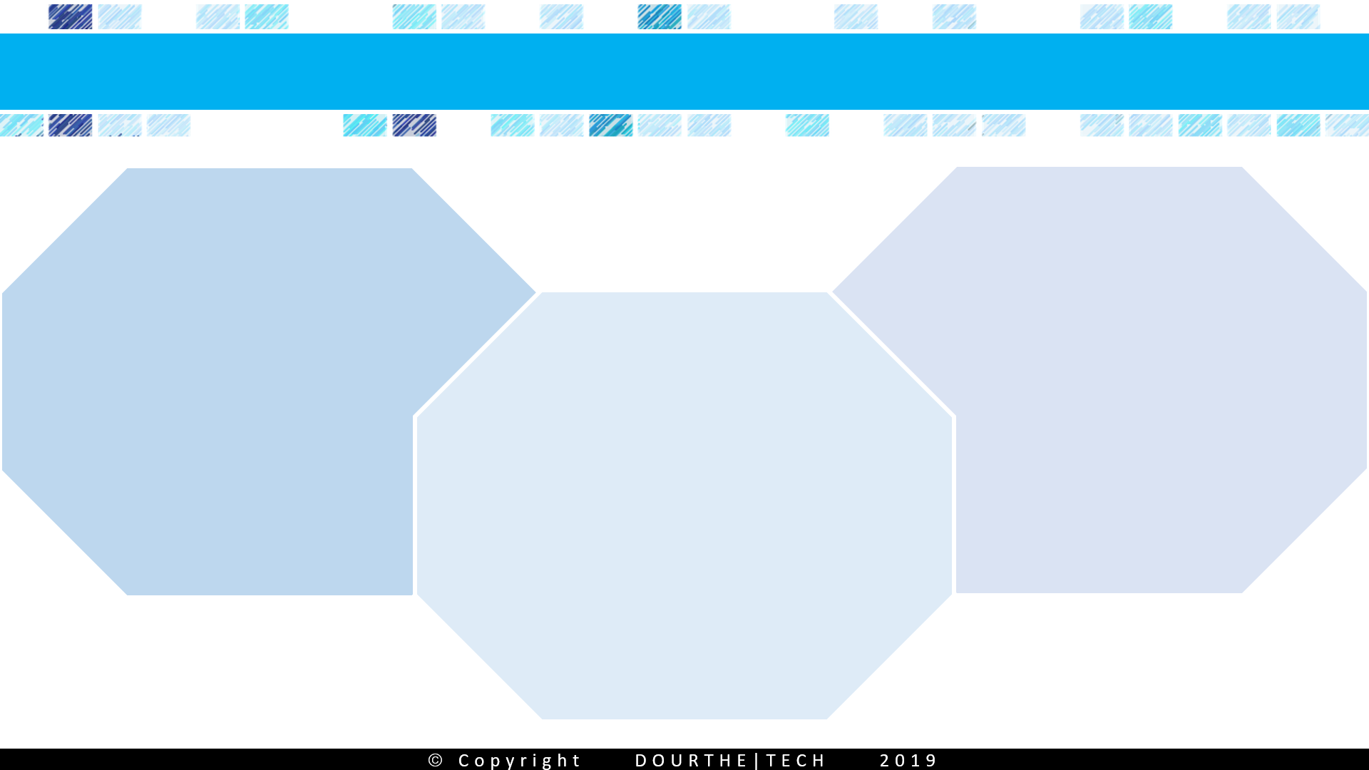
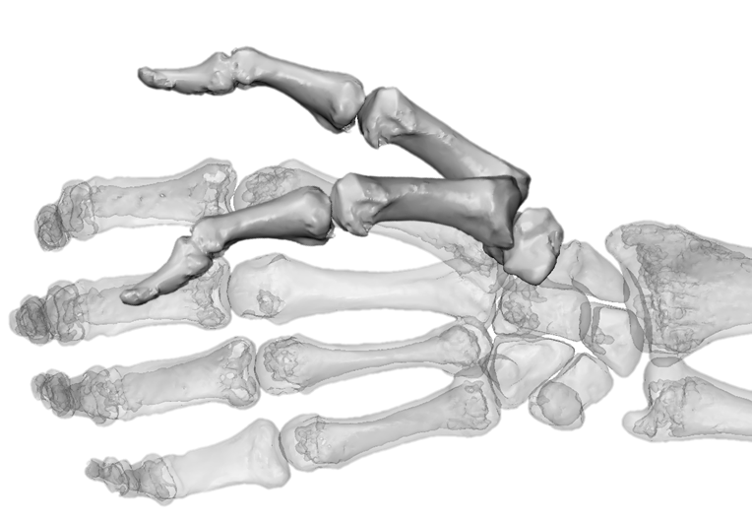
Assessing thumb mobility using medical imaging
Collect CT scans
of the hand
during task
(e.g. thumb flexion)
Compare
mobility
between healthy
volunteers and patient affected
by a joint
condition
(i.e.
osteoarthritis)
Using
reconstructed
3D models
calculate thumb movement from position 1
to position 2
(via ICP algorithm)

Slide 45
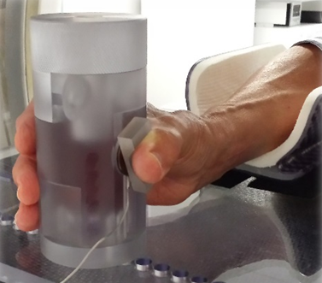
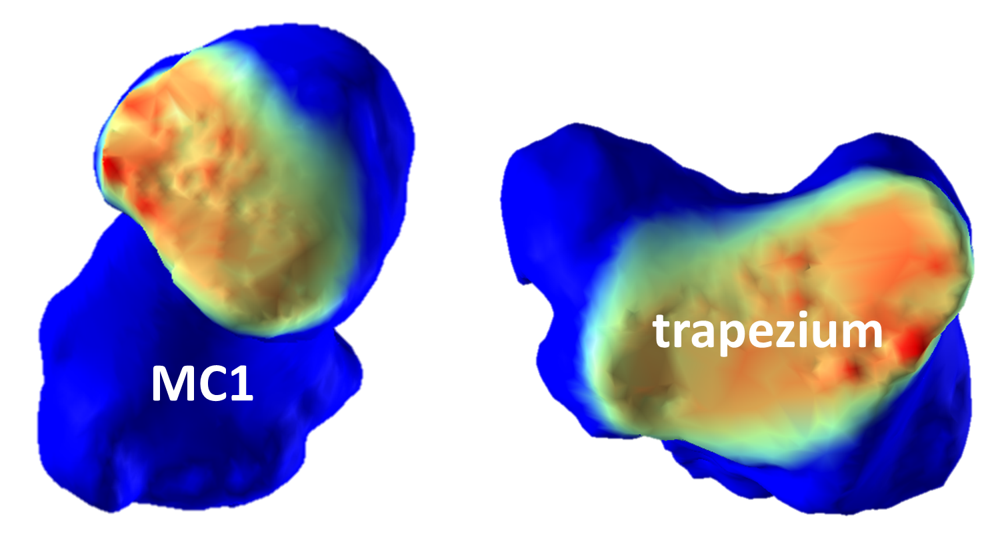
PURPOSE- assess how contact pressure is distributed in the thumb joint in vivo during functional tasks and better understand how degenerative diseases such as osteoarthritis occur.
METHODS
STEP 1- CT scan collected in a custom rig with embedded load cell during functional task.
STEP 2- 3D reconstruction of the hand.
STEP 3- Design of an algorithm estimating
intra-articular joint pressure based on a biomechanical model of the cartilage.
STEP 4- Comparison of pressure
distribution patterns between tasks.
RESULTS
FINDING 1- The mean contact pressure
in the thumb was similar between the neutral and lateral pinch configurations.
FINDING 2- The highest peaks in contact pressure were found during power grasp.
FINDING 3- Peak pressure was consistently located around the volar and radial regions of the thumb during power grasp.
FINDING 4- These results may explain why degenerative changes are usually observed in this location during the primary stages of osteoarthritis development.
CONCLUSION- the algorithm developed for this study is a valuable tool that allows clinicians to estimate the distribution of contact pressure within joints in vivo.
© Copyright DOURTHE|TECH 2019

